Slide 1
Great Resignation - Interview and Survey Report
01
Presented by: Kimberly Barnes, Udhaya Kumar, Tian Xia
Notes:
Template created by SlideCarnival: https://www.slidescarnival.com/lodovico-free-presentation-template/9808
Time Allocation Split
Introduction
Background (Kim) 30 sec
Why did we care (Kim) 30 sec
Research process (Kim) 30 sec
[slide: team] (Kim) 30 sec
[agenda] (Kim) 30 sec
Workflow
What we thought (Tian) 1 minutes
What we learned (Tian) 1 minutes
In-depth research or workflow details
Interviews (Tian) 5 minutes
Questionnaire (Kim) 5 minutes
Usability Tests (Uday) 4 minutes
Surprising findings (Uday) 3 minutes
Wrap up
Takeaways (Uday) 3 minutes
Next steps
How we’d investigate deeper (Uday) 2 minutes
How to design work that meets the needs of workers? (Kim) 1.5 minutes
Roadmap to figuring out if it’s time to quit (Kim) 1.5 minutes
Questions? 5 minutes

Slide 2
4.4 million Americans
quit their jobs this September
Source: The Washington Post
Notes:
A record number of 4.4 million Americans left their jobs in September, which appears to show a sign of how an imbalance in the labor market, ignited by the pandemic in 2020- which also showed the previous record of 4.3 million people quitting their jobs last August.

Slide 3
“Americans are re-assessing the way they work” CNBC, YOUTUBE
Notes:
Having lived through the pandemic and observing how the pandemic impacted the working life of those around us, it sparked the interest of the team to understand the considerably new phenomenon happening as we speak.

Slide 4
The purpose of our research was to identify the reasons in which the American professional workforce is quitting or resigning voluntarily from their jobs at a more rapid pace in response to the COVID-19 pandemic.
Notes:
The purpose of our research is to identify the reasons in which the American professional workforce is quitting or resigning voluntarily from their jobs at a more rapid pace in response to the COVID-19 pandemic. The focus will be on the social, environmental, and economic impacts that were prompted by a global pandemic.

Slide 5
Research Process
One-on-one Interviews
Questionnaire
Usability test plan
Conducted 9 Zoom interviews to capture descriptive research with American professionals
Distributed questionnaire via Mechanical Turk survey to 100 participants
Validation/verification, unmoderated test on job-searching website
Notes:
We used a variety of qualitative research methods to capture relevant information needed to evaluate answers to our hypothesis as well as next steps.

Slide 6
“Great Resignation” Team
Introducing your moderators/investigators/surveyors:
Kimberly Barnes
Udhaya Kumar
Tian Xia

Slide 7
Agenda
What We Thought/What We Learned
In-Depth Research and Workflow Details
Surprising Findings
Takeaways
Next Steps

Slide 8
What we thought...
Mostly entry to mid-level professionals between the ages of 20 and 40 were more likely have quit a job during the pandemic for the following reasons:
Bad management and leadership
Not feeling recognized at their job (both monetary and not)
Not satisfied with their office’s work accommodations

Slide 9
What we learned...
Regardless of professional years, professionals quit a job during the pandemic for the mainly because of
Bad management and leadership bad response to the pandemic and de-motivating them
The inability to hone in on professional skills in the office
Not feeling recognized at their job
A desire for more work life balance and pursue hobbies that inspire [them]
Notes:
When going into the research further, We were under the impression that our follow up survey and usability testings would support similar themes that we found for participants who quit their current line of work and pursued other opportunities.

Slide 10
Research & Workflow

Slide 11
Interview Research (Snapshots, Affinity diagrams, etc.)

Slide 12
Objectives
Some of the research questions we addressed are:
What are the factors that contribute to the American worker deciding to quit their job?
What social, environmental, and economic factors impacted the decision to quit or resign voluntarily?
What economic, social, and environmental decisions/arrangements were made prior to quitting?

Slide 13
Recruitment Plan & Process
In our research, we conducted 30-minute qualitative interviews with 9 interviewees using convenience sampling using Zoom and were transcribed and coded using Dovetail.
For our interview, our structure included a pre-study briefing, a warm up, interview, and post-interview studies and analysis.
See Appendix for Research Plan
Notes:
Questions asked during the interview included things like About The Interviewee, Prior to the Pandemic, Prior to Quitting, Quitting the Job and of course wrapping-up.

Slide 14
Recruitment Plan & Process
In our post-interview studies and analysis, we coded our interview to find similar groupings and differences. A combined codebook was created so that we could look for similar themes across all 9 participants. You can find these in our affinity diagrams.
See Appendix for Research Plan
Notes:
Questions asked during the interview included things like About The Interviewee, Prior to the Pandemic, Prior to Quitting, Quitting the Job and of course wrapping-up.

Slide 15
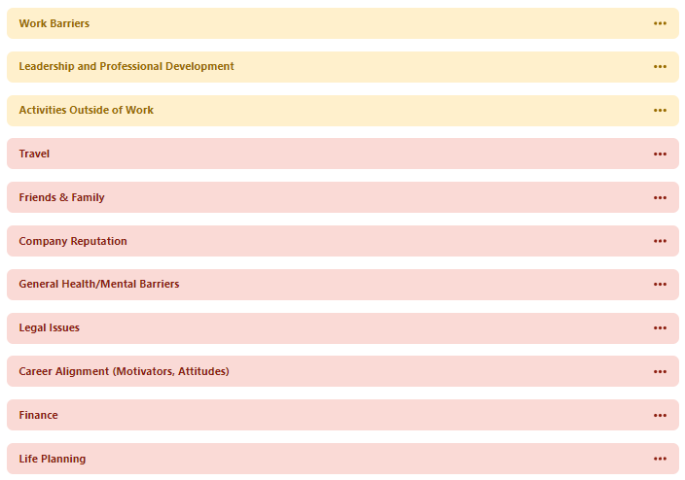
Affinity diagram - Themes
See Appendix for Affinity Diagrams
Notes:
See codebook as seen in Dovetail here. 11 themes

Slide 16
Top Three Coded Themes from Interviews:
See Appendix for Affinity Diagrams
Notes:
See codebook as seen in Dovetail here.

Slide 17
See Appendix for Affinity Diagrams

Slide 18
Recruitment Plan & Process
As we created our codebooks and identified themes, it also made it easier to digest by finding relevant participant quotes and created Interview Snapshots, which best reflected their feelings at the time.
Of all those interviewed, we were able to derive four general motivations for quitting their job. They can be described as: Working on a Passion, Altruistic, Security at Work/Work-Life, Monetary.
See Appendix for Interview Snapshots
Notes:
Questions asked during the interview included things like About The Interviewee, Prior to the Pandemic, Prior to Quitting, Quitting the Job and of course wrapping-up.

Slide 19
[P1]
User Tags
Motivations
Tech Industry
Family support
Working on a Passion
Unsupported by management
Altruistic
Looking for better job
Security at Work/Work-Life
Goals
Name: Ellen
Age Range: 25-35
Occupation: QA engineer
Location: Needham, Massachusetts
Being able to have more time with family and friends.
Having work life balance.
Monetary
Bio
I feel like my previous job not only was the company not really interesting to me or aligned with my passion, but also, as I said, they weren't being flexible with my working location. I kind of believe that I'm capable of doing my job outside of the office and they didn't agree.
A female engineer who used to work in a software company in Vermont now live with her parents. Having work life balance and enjoying time with family are the most important things to her.
Frustrations
Previous employer are not flexible on working remotely.
She has no motivation in previous company
Do not have enough spare time.
Notes:
Use this avatar generator to create an image of your user: https://picrew.me/image_maker/94097
Age ranges to use:
< 25
25-35
35-45
45-55
55 <
Blue box includes a quote that best illustrates their feeling about the great resignation.
Bio is short description of their situation.
Motivations should remain as usual. Make sure to only move the yellow filled square. Maintain same categories.
Don’t forget to maintain same P# on top right.
User Tags to Consider: Career Pivoter, Tech Industry, Unsupported by Management, Receives Family Support, Money Habits, Focus on Work-Life Balance, Focus on Personal Health

Slide 20
[P3]
User Tags
Motivations
Career pivoter
Tech industry
Working on a Passion
Receive family support
Altruistic
Passionate worker
Security at Work/Work-Life
Goals
Name: Alice
Age Range: <25
Occupation: Youtuber
Location: Mountain View, California
Making great video content for her youtube audience
Learn more technology
Be financially independent
Monetary
Bio
And now, as an YouTube creator, there's so much more skills that I need from thinking about the content, writing a script, filming the actual video, editing the video and even marketing how to probably mark in a video so that I'm making the right content for my viewers.
A great career pivoter from software engineer to video designer. Making quality youtube video for her audience is important to her.
Frustrations
Do not have working remote policy in previous job
Feel less motivated in the previous software company
Notes:
Use this avatar generator to create an image of your user: https://picrew.me/image_maker/94097
Age ranges to use:
< 25
25-35
35-45
45-55
55 <
Blue box includes a quote that best illustrates their feeling about the great resignation.
Bio is short description of their situation.
Motivations should remain as usual. Make sure to only move the yellow filled square. Maintain same categories.
Don’t forget to maintain same P# on top right.
User Tags to Consider: Career Pivoter, Tech Industry, Unsupported by Management, Receives Family Support, Money Habits, Focus on Work-Life Balance, Focus on Personal Health

Slide 21
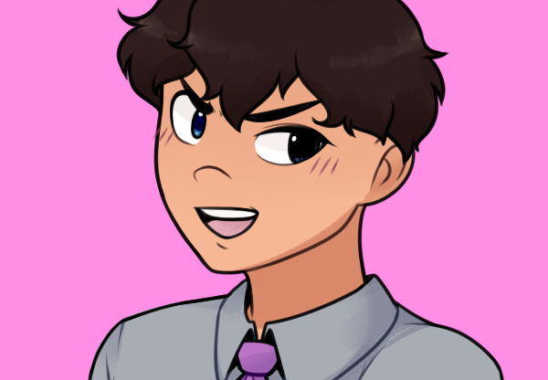
Interview Participant Quotes:
P3: “So I was able to just focus on myself, a workout plan. So I've started a workout plan once I quit, or I got to focus more on my health, I would say, because now it's like, I was able to create a consistent routine for myself.”
P6: “I was negotiating my sort of role in this new company, one of the caveats that I had”
P6: “So I didn't want my work stress to impact my interactions with my family and friends.”
See Appendix for Interview Snapshots

Slide 22
Interview Participant Quotes:
P5: “And I'm also learning some development skills that I didn't have before.”
P7: “[...] Not really interesting to me or aligned with my passion, but also, as I said, they weren't being flexible with my working location.”
P5: “Remotely is hard because when you're [in] an office, if something comes up, you can just ask a question, not loud and it's fine doing it. Or you can do it on teams, of course, but it's still not the same.”
P5: … “And they would listen to [my male coworker] and completely ignore me even in email threads, like even in writing, it was so frustrating. And so I just didn't want to work in that environment anymore.”
See Appendix for Interview Snapshots
Notes:
Working on a passion, being able to learn more professional skill, work-life balance,

Slide 23
Questionnaire (Qualtrics, mTurk, Analysis)

Slide 24
Recruitment Plan & Process
We acquired at least 100 participants for each of our surveys through circulating the survey link using Mechanical Turk and creating our questionnaire via Qualtrics. We relied on convenience and purposeful sampling for our recruitment plan.
Each investigator created a questionnaire based on our top three themes discovered in our affinity diagramming process: Work Barriers, Leadership and Professional Development and Activities Outside of Work.

Slide 25
Work Barrier Survey Answers
of Note

Slide 26
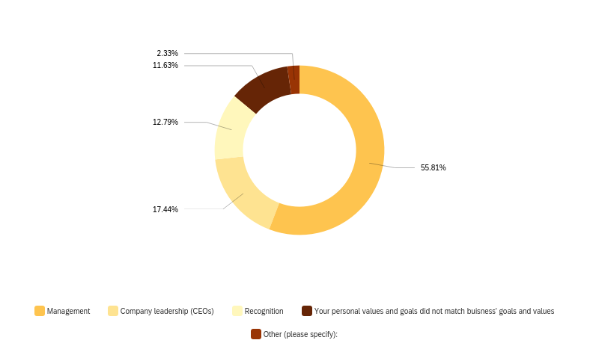
Question: What was the top reason you left your most recent job? Pick an answer that most affected your reason to quit.
Notes:
Majority of the participants stated that their top reason for leaving their job was “Management” (48 participants) followed by 15 participants who blamed company leadership (CEOs, Directors).

Slide 27
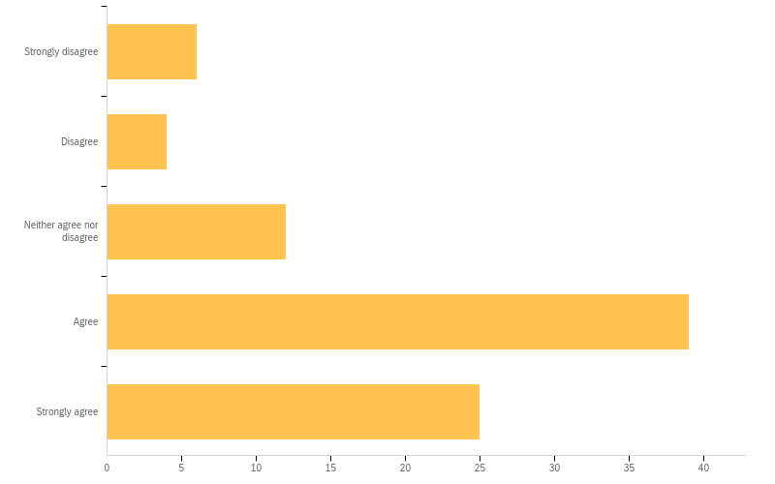
Question: I felt recognized in my workplace in the role I recently quit.
Notes:
Most participants felt recognized in their previous role- 39 candidates saying they “Agree” and 25 participants saying ‘Strongly agree”.

Slide 28
Work Barriers Research Summary
Based on our survey, there is no strong correlation between the experience level of the participant and the reasons that the participant left their job voluntarily.
Based on our survey, the top reason that professionals quit their job was due to bad management and company leadership.
The majority of participants did some type of research prior to quitting. Those things included their focus on professional development and working on new skills, speaking with family and friends, and more.

Slide 29
Leadership and Professional Development Survey Answers of Note

Slide 30
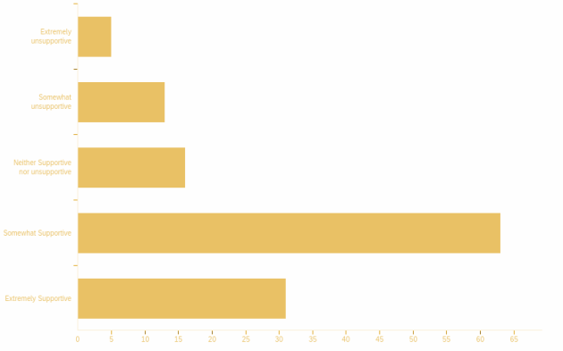
Question:How well does your organization support you in exploring your professional interests and goals?

Slide 31
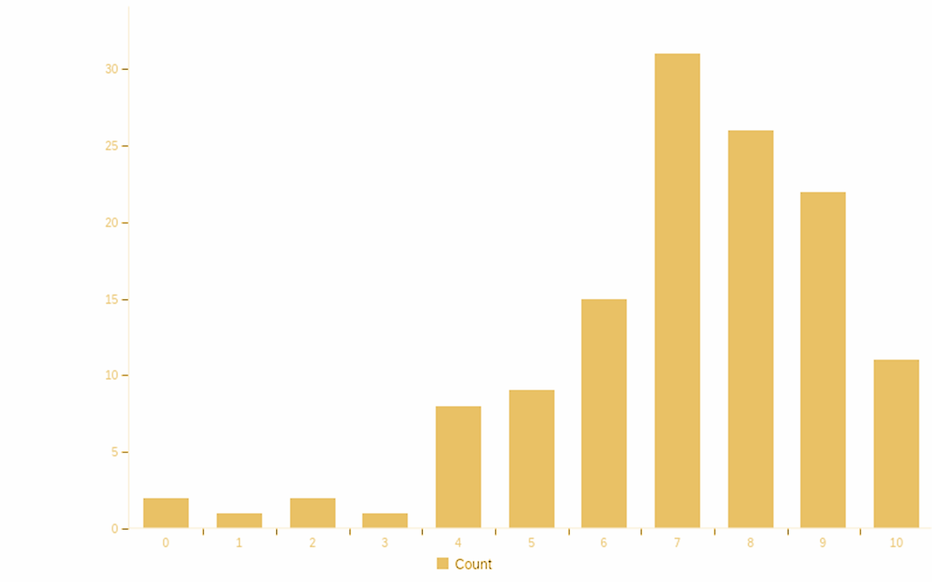
Question: On a scale of 1-10 how likely you’ll have the opportunity to reach your full potential at your organization?

Slide 32
Leadership & Professional Development Research Summary
For some workers, the pandemic precipitated a shift in priorities, encouraging them to pursue a ‘dream job’, or transition to being a stay-at-home parent. But for many others, the decision to leave came as a result of the way their employer treated them during the pandemic.
The top three skills that the users wanted to see in them develop were time management, cross functional skills and team management.
Most of the people also agreed to the fact that they had all the opportunities to develop their skills at their present company.

Slide 33
Activities Outside of Work Survey
Answers of Note

Slide 34
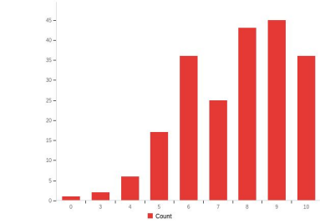
Question: On a scale of 1-10, what do you think of work-life
balance?
Notes:
Among the 212 respondents,
people give 7.67 in average for
the importance of the work-life
balance. We can see it is fairly
important for people who quit
their job voluntarily during the
pandemic.

Slide 35
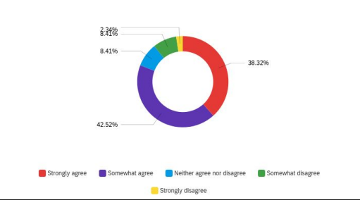
Question: Rate your agreement or disagreement with the
following: I have enough spare time to spend on my
hobbies from my new job.

Slide 36
Activities
Outside
of Work
Research Summary
People who quit their job are getting more time and opportunity to do their hobbies. Being able to spend time hobbies and things that they are interested in and passionate about is what people take into account when getting a job.
Participants also want to have enough time to do volunteering outside of work.
Participants described that the advice (and monetary support) of their family and friends (social factors) were a significant factor in quitting their jobs.

Slide 37
Usability Assessments (UserTesting, Analysis)

Slide 38
Recruitment Plan & Process
We acquired 9 participants for our usability testing of a job website called getWork website (https://getwork.com) from the perspective of a new user. Validation/Verifications were used to measure the usability against the set benchmarks.
The participants will be expected to complete a set of tasks presented to them in as efficient and timely manner as possible (expected about 15-20 minutes) and provide honest feedback in an unmoderated session using UserTesting.com.
Notes:
The purpose of this test is to evaluate the usability of the getWork website (https://getwork.com) from the perspective of a new user. The specific goals include:
Find desired positions in your area of interest
Select jobs in your area
We selected it because it’s not as popular as a website like linkedin.

Slide 39
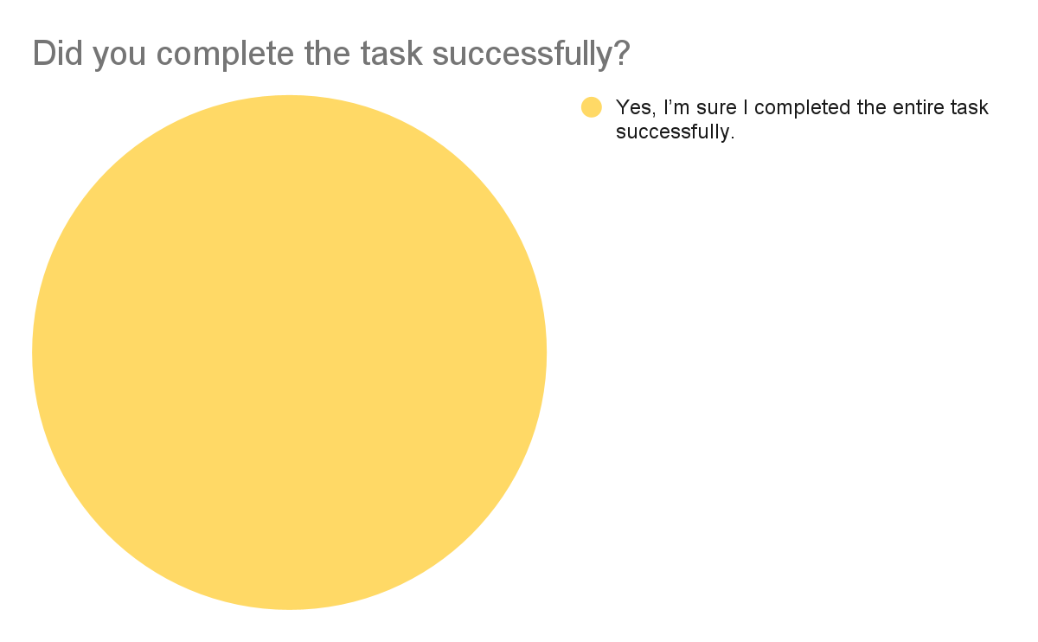
Task 1:
Search for Product Manager openings in Seattle and navigate to the job listing. Walk through the steps of how to get there. When you’ve navigated to the job listing, proceed to the next task.
Averages
01:13
2
11
Time on task
Screens
Interactions
Difficulty of Question
Very Easy (5)
All participants described the task in this way.
Notes:
Kim’s…

Slide 40
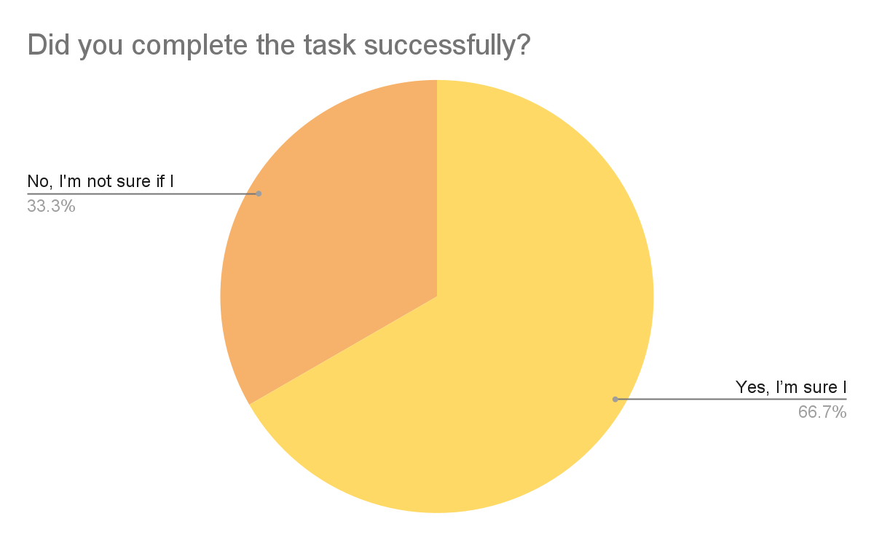
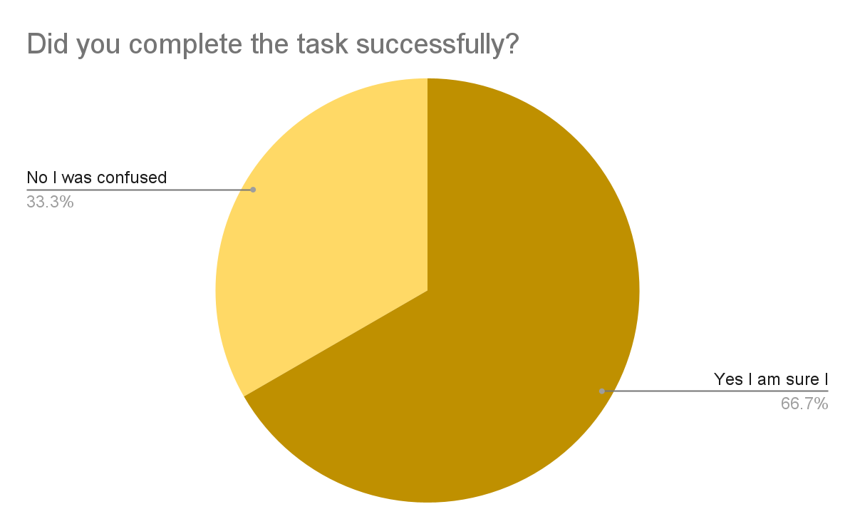
Task 2:
Explore the job description of a Sr. Product Manager, Amazon Dx position at Seattle, WA location. Speak your thoughts out loud. Once you’ve reviewed key insights to the job requirement, navigate to the direct job listing. You do not need to apply for the position. When you’ve navigated to the job listing, proceed to the next task.
Averages
03:24
10
42
Time on task
Screens
Interactions
Difficulty of Question
Somewhat Easy (2,3,4)
One participant described the task is confusing.
Notes:
Kim’s…

Slide 41
Task 3:
Find a blog post of interest. Speak your thoughts out loud as you look.
Averages
01:22
4
6
Time on task
Screens
Interactions
Difficulty of Question
Very Easy (5)
All participants described the task in this way.
Notes:
Kim’s…

Slide 42
Key observations that were made:
Participants were able to quickly find a general job they wanted to apply to
Participants only searched for positions in one way- on the homepage using their mobile device
Participants naturally gravitated towards the “Job seekers” blog and not the “Employers” blog
Participants were unlikely to go past page 2 or 3 when searching for job title results
Candidates were able to complete the test in a much shorter time frame than anticipated.
Participants weren’t navigating to the search bar instead they were just scrolling through the job listings

Slide 43
Key observations that were made:
When asked for our specific role and company, participants had trouble looking for the role. It was not intuitive to search the company as well as a keyword
Time taken when looking for a specific role seemed to take longer than usual.
Participants were unsure of the title in general, which made it difficult to search. This is likely a rare scenario in reality.
Participants did not walk through their specific reasons for selecting any specific blogs.

Slide 44
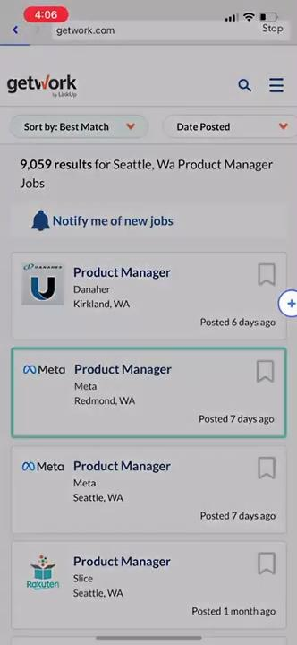
User Testing Highlight Reel #1
Participant reel showing the ease of finding job.

Slide 45
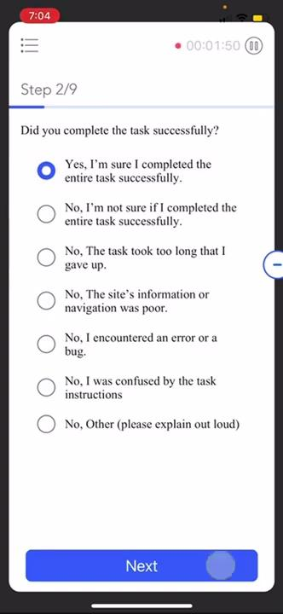
User Testing Highlight Reel #2
Participant reel of Task 2 and the difficulties.

Slide 46
Most Surprising Findings

Slide 47
Dichotomies between participants say and do.
In our “Work Barriers” questionnaire, participants saying bad leadership is the reason why they left, but also in a number of questions, participants stating they “agree” or “strongly agree” with their employer empowering them to make decisions or supported their professional development.

Slide 48
Working in the office does not conflict with their work-life balance values
In our “Activities Outside of Work” questionnaire, 70% prefer working in the office, but also highly value work life balance.

Slide 49
Users can be skewed by previous actions
In our usability tests, all three instructors recognized that users were unlikely to first search for a role when looking for a specific job title if it was similar to what was in the previous instruction/task.

Slide 50
Wrap-Up

Slide 51
Takeaways

Slide 52
In our interviews, we found the following insights:
Interviewees described that workforce barriers discouraged them from continuing their work impacted their productivity and work satisfaction.
Interviewees felt that they were undervalued at their place of work and describe the desire to find opportunities elsewhere that would allow them to improve their skills, align their skills with their work, which they found as a valuation factor of their knowledge
Interviewees may have also quit their job so they could pursue a better life outside of work and to gain flexibility in their schedule and more work-life balance.
Notes:
Summary based on group summary report:
One of the major themes for the reason that the American professional workforce quit their jobs was due to workforce barriers that discouraged these professionals from continuing their work. This would constitute social and environmental impacts. These work barriers in their previous workplaces may impact not only their productivity, but work satisfaction. Overall, professionals described being unsatisfied with their job in a number of ways. Additionally, a number of respondents describe challenges that made it harder to go back to work.
Users felt that they were stuck up at the same work for a longer period of time, which made a professional gap between their personal and professional line of work. Also, their key skills and knowledge were undervalued, which made them do the underrated work than their actual capacity. The users also found vast opportunities open out there, which enabled them to improve their skills, align their skills with their work, which they found as a valuation factor of their knowledge.
Another reason that the American professional workforce quit their jobs was because they want to pursue a better life outside of work. Quitting their job can give them more flexibility in their schedule. They can have more spare time to spend with their family and friends, pursue their hobbies, and enjoy whatever they want to do that they couldn't do previously. Many people who resign their job value the work life balance the most.

Slide 53
Next Steps

Slide 54
How To Investigate Further

Slide 55
How we’d investigate further...
Consider re-writing the survey and unmoderated task questionnaire to clarify objectives to participants
Identify additional job searching websites that participants who quit their job voluntarily might use
Utilize Qualtrics at its full potential so we can work through additional screening to avoid different survey participants in questionnaire
Create a more diverse sample of participants- most participants came from convenience sampling via social media with tech-leaning interests

Slide 56
Recommendations

Slide 57
How Can Employers Improve the Workplace?

Slide 58
Employers can react positively to the Great Resignation by...
Remaining flexible with employees to choose their own work location
Prioritizing and emphasizing on supporting employee mental (and physical) health through company initiatives and providing them the time to take care of themselves
Adopt a spirit of transparency
Treat employees with empathy and kindness and encourage a culture to behave accordingly
Source: Worth, Contributor Devin Partida
Notes:
Source: https://www.themuse.com/advice/should-you-quit-great-resignation-covid

Slide 59
When Should We Quit?

Slide 60
Ask yourself the following...
Clarify the workplace needs and how you spend your time in the office
Clarify your long-term goals
Identify your “no gos”
Did my leaders or company overall react with compassion or support its workers during the pandemic? What changes did they make in the organization?
Do you have a plan to bounce back independently, or do you have a support system you can rely on?
Source: The Muse, Contributor Nell Wulfhart
Notes:
Source: https://www.themuse.com/advice/should-you-quit-great-resignation-covid

Slide 61
Thank you!
Questions?

Slide 62
Appendix
Appendix: Affinity Diagrams
Appendix: Survey Questions
Appendix: Interview Snapshots
Appendix: Research Plan

