Slide 1
Analysis
Frank, Kim, Steven

Slide 2
Customers want:
To offload their communications
Not have to build an entirely new infrastructure to leverage communications
Smaller organizations are looking for cost-effective options

Slide 3
Twilio is a customer communications that “uses intelligent sending features to ensure messages reliably reach end-users wherever they are”
Source: Twilio

Slide 4
Executive
Summary

Slide 5
A Brief History of Twilio

Slide 6
CEO:
Source: Twilio
Founded in 2008 by Lawson, Cook & Wolthius
Acquired startup two-factor services startup Feb 2015
Acquired SendGrid Oct 2018
Acquired Zipwhip May 2021
Launched their first APIs to market between 2008-2011
Went Public in June 2016
Acquired Segment Oct 2020
Source: Wikipedia

Slide 7
Product Portfolio

Slide 8
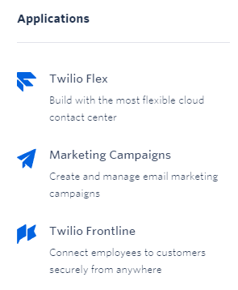
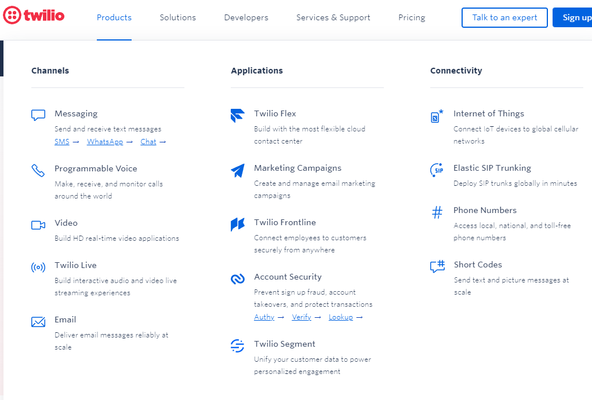
Source: Twilio.com

Slide 9
Market
Positioning
Source: Forbes

Slide 10
Audience Positioning:
Developers are the “stars” of the show- they’re focused on appealing to in-house developers

Slide 11
Marketing Strategies
Social-Proof Marketing
Twilio leverages testimonials and different customer showcases & testimonials
Micro-Marketing
Twilio uses a dual-sales model along with conferences and content marketing to drive sales
Lock-In Marketing
The more Twilio products that a company relies on, the harder it becomes to switch to another vendor

Slide 12
Customer
Stories

Slide 13
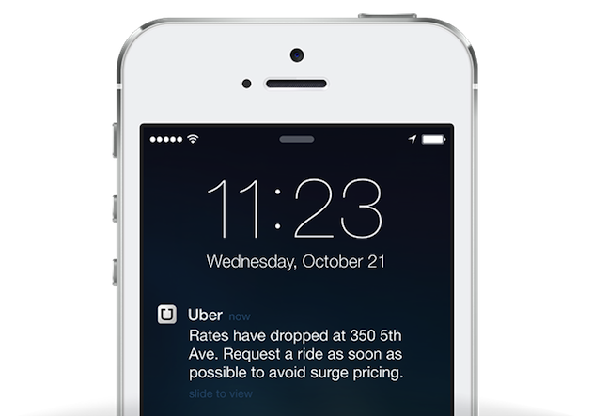
400+
1B
Customer: Uber
Uber built a new ridesharing experience with SMS & Voice to keep customers up to date with real-time ETA alerts delivered as a text.
Cities served globally
Rides given
Source: Twilio Customer Showcase

Slide 14
Financials

Slide 15
Financials
$614.4M
10
$52.07B
Total funding amount
Acquisitions
Enterprise Valuation
Source: CrunchBase, Yahoo! Finance

Slide 16
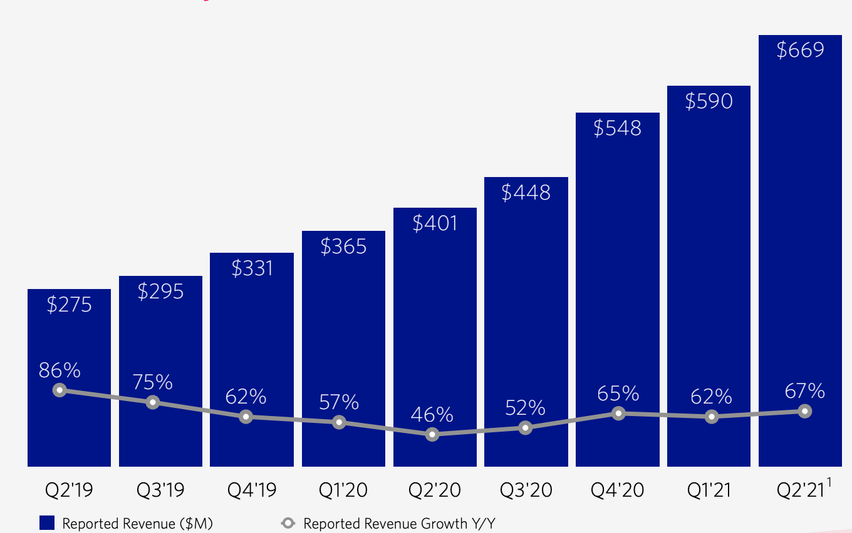
Quarterly Revenue
Source: Twilio Signs Definitive Agreement to Acquire Segment

Slide 17
55%
137%
240,000
2020 Revenue growth Y/Y
Dollar-Based Net Expansion Rate
Total Active Accounts in 2020
Source: Twilio Earning Results(2021)

Slide 18
Operation Metrics
$5
Number of Active Customer Accounts
Per Month Threshold
Source: Twilio Q2 2021 Earnings Results

Slide 19
Operation Metrics
Dollar-Based Net Expansion Rate
Customers reduce their usage of a product
Company lowers usage prices on a product
Customers increase their usage of a product
Source: Task 3

Slide 20
Risks

Slide 21
Risks
Risk 1: Consumer in-house solution
Core business
Communication Service
Source: Twilio Q2 2021 Earnings Results

Slide 22
Risks
Risk 2: International Expansion
Regulatory Risks
Financial Risks
Political Risks
Source: Twilio Q2 2021 Earnings Results

Slide 23
Should You
Buy?

Slide 24
NYSE:TWLO Consensus:
A Good Buy

Slide 25
Reasons to Buy:
Hyper growth markets
Pay-as-you-go pricing strategy
Source: Sec

Slide 26
Any questions?
Thanks!
Template created by SlidesCarnival

